Slide 1
Distributed Computer Systems
CT024-3-3-DCOMS and Version 0416
Name Services

Slide 2
Topic & Structure of The Lesson
General concepts
Domain Name System (DNS)
Directory and Discovery Services
Introduction
Jini
Global Name Service (GNS)
X500 Directory Service

Slide 3
Learning Outcomes
At the end of this topic, You should be able to
Understand the concepts of naming services
Explain about the Domain Name System (DNS)
Various Directory and Discovery Services
Introduction
Jini
Global Name Service (GNS)
X500 Directory Service

Slide 4
Key Terms You Must Be Able To Use
If you have mastered this topic, you should be able to use the following terms correctly in your assignments and exams:
Naming services
Domain services
Directory services

Slide 5
Introduction
In a distributed system names are used to refer to a wide variety of resources such as computers, services, remote objects, and files as well as users.
Names facilitate communication and resource sharing.
Names are used for identification as well as for describing attributes.
For many purposes, names are preferable to identifiers
because the binding of the named resource to a physical location is deferred and can be changed
because they are more meaningful to users

Slide 6
Name, Addresses and other Attributes
Any process that requires access to a specific resource must possess a name or identifier for it. Ex: URL http:://www.cdk3.net/
A name has to be looked up before it can be used.
A name is said to be resolved when it is translated into data about the resource or object.

Slide 7
Names and Binding
Names are bound to the attributes of named objects (and not to any specific implementations.)
The association between a name and an object is called binding.
Services are written to map between names and the attributes of objects they refer to.
Example: domain name→ Domain name Service (DNS) maps → attributes of the host computer

Slide 8
Name Service
A name service stores a collection of one or more naming contexts – sets of bindings between textual names and attributes for objects.
Provides a general naming scheme for entities (such as users and services) that are beyond the scope of a single service.
Major operation: resolve a name - to look up attributes from a given name
Other operations required: creating new binding, deleting bindings, listing bound names and adding and deleting contexts.

Slide 9
Name Spaces
A name space is a collection of all valid names recognized by a particular service
Allow simple but meaningful names to be used
Potentially infinite number of names
Structured
to allow similar subnames without clashes
to group related names
Allow re-structuring of name trees
for some types of change, old programs should continue to work
Management of trust

Slide 10
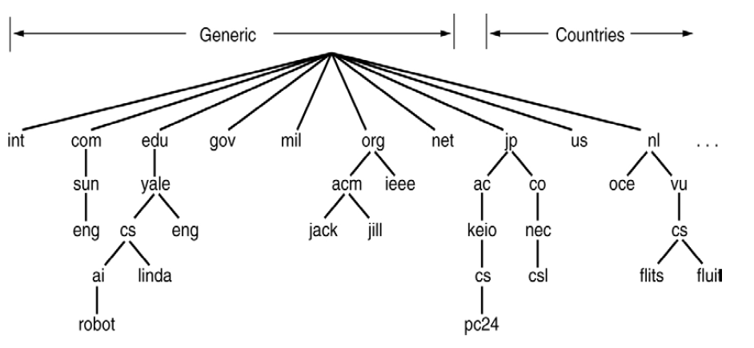
Name Space

Slide 11
The Domain Name System
A distributed naming database
Name structure reflects administrative structure of the Internet
Rapidly resolves domain names to IP addresses
exploits caching heavily
typical query time ~100 milliseconds
Scales to millions of computers
partitioned database
caching
Resilient to failure of a server
replication

Slide 12
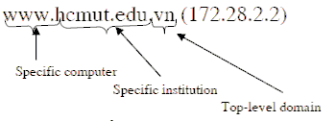
Parts of a domain name
Usually consists of two or more parts (technically labels), separated by dots. .
The rightmost label conveys the top-level domain.
Each label to the left specifies a subdivision, or subdomain of the domain above it.

Slide 13
DNS name servers
The Domain Name System consists of a hierarchical set of DNS servers
Each domain or subdomain has one or more authoritative DNS servers that publish information about that domain and the name servers of any domains "beneath" it
The hierarchy of authoritative DNS servers matches the hierarchy of domains.
At the top of the hierarchy stand the root nameservers: the servers to query when looking up (resolving) a top-level domain name

Slide 14
Directory and Discovery Services
Directory services
Attribute-based name services
Attributes are used as values to be looked up
Textual name can be considered to be just another attribute

Slide 15
Directory and Discovery Services
Discovery services
Directory service that registers services provided in a spontaneous networking environment
Provide an interface for automatically registering and de-registering services, as well as an interface for clients to look up the services they require
Ex : a printer (or the service that manages it) may register its attributes with the discovery service as follows :
‘resourceClass = printer, type=laser, color=yes, resolution=600dpi, location=room101, url=http://www.hotelNW.com/services/printer98’

Slide 16
Jini Discovery Service
Designed to be used for spontaneous networking
Entirely java-based
Computers communicate by means of RMI, and can download code if necessary
Discovery-related components in a Jini system are look up services
A Jini service (such as printing service) may be registered with many look up services

Slide 17
Jini Discovery Service
How to locate the look up service ?
Using a well-known multicast IP address
Multicast the request using a “time to live” value
Look up services announce their existence to the same multicast address
Service instance is configured with one or more group names such as ‘finance’, ‘sales’, ‘admin’, which act as scoping labels.
Limited period of time

Slide 18
Global Name Service (GNS)
Designed and implemented by Lampson and colleagues at the DEC Systems Research Center (1986)
Provide facilities for resource location, email addressing and authentication
When the naming database grows from small to large scale, the structure of name space may change
the service should accommodate it
Cache consistency ?

Slide 19
GNS Structure
Tree of directories holding names and values
Muti-part pathnames refer to the root or relative working directory (like Unix file system)
Unique Directory Identifier (DI)
A directory contains list of names and references
Leaves of tree contain value trees (structured values)

Slide 20
X500 Directory Service
Standard of ITU and ISO organizations
Organized in a tree structure with name nodes as in the case of other name servers
A wide range of attributes are stored in each node
Directory Information Tree (DIT)
Directory Information Base (DIB)

Slide 21
X.500 service architecture
DUA
DSA
DSA
DUA
DSA
DSA
DSA
DUA
DSA
Directory Server Agent (DSA)
Directory User Agent (DUA)

Slide 22
Summary
In a distributed system names are used to refer to a wide variety of resources such as computers, services, remote objects, and files as well as users.
Names facilitate communication and resource sharing.
Names are used for identification as well as for describing attributes.

Slide 23
Question and answer session
Q & A

Slide 24
What we will cover next
Windows Communication Foundation

